Slide 1
US superstore sales dashboard

Slide 2
OBJECTIVE
To present an overview of sales from a superstore in the United States over the past few years using data visualization methods.
DATA
The data used is sample sales data from a superstore in the United States, consisting of several variables, such as order date, shipping location, sales value, profit value, quantity sold, and more.
This portfolio was created by following a YouTube video by Data With Baraa, with some modifications added. To see the full video, click here

Slide 3



DATA NAVIGATION BUTTON

Slide 4
DATA NAVIGATION BUTTON
Sales Dashboard Button
This button directs the user to the Sales Dashboard.
Customer Dashboard Button
This button directs the user to the Customer Dashboard.
Filter Button
This button displays several filters that allow users to adjust the data display based on their selections.

Slide 5
SALES DASHBOARD CONTENT

Slide 6
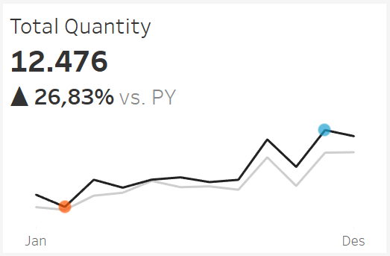
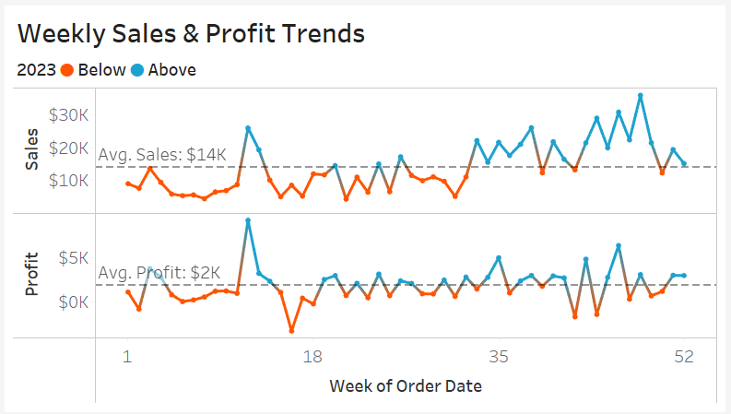
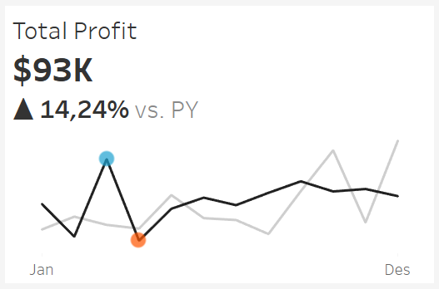
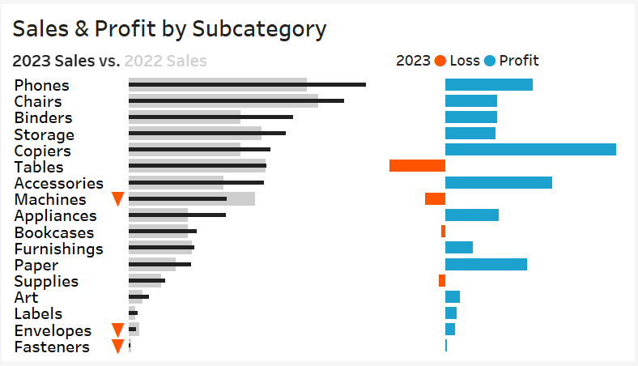
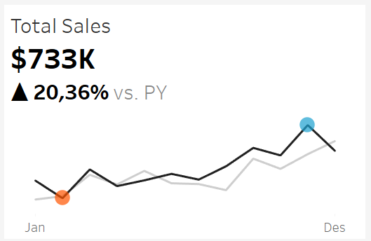
SALES DASHBOARD CONTENT
Total Sales Section
This section shows the total sales, the increase/decrease in sales compared to the previous year (YoY), and the monthly sales trend between the year selected by the user and the previous year.

Slide 7
SALES DASHBOARD CONTENT
Sales & Profit by Subcategory Section
This section displays the total sales by subcategory between the year selected by the user and the previous year, as well as the total profit/loss by subcategory for the year selected by the user.

Slide 8
SALES DASHBOARD CONTENT
Total Profit Section
This section shows the total profit, the increase/decrease in profit compared to the previous year (YoY), and the monthly profit trend between the year selected by the user and the previous year.

Slide 9
SALES DASHBOARD CONTENT
Weekly Sales & Profit Section
This section shows the weekly trend of sales and profit for the year selected by the user.

Slide 10
SALES DASHBOARD CONTENT
Total Quantity Section
This section shows the total quantity, the increase/decrease in quantity sold compared to the previous year (YoY), and the monthly trend of quantity sold between the year selected by the user and the previous year.

Slide 11
CUSTOMER DASHBOARD CONTENT

Slide 12
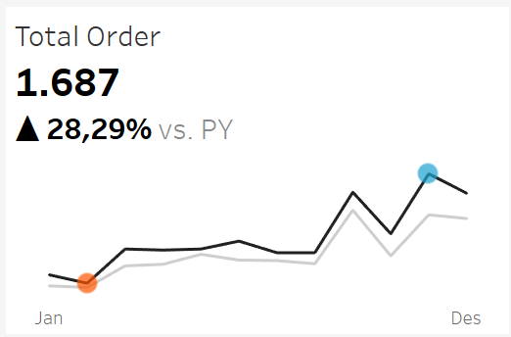
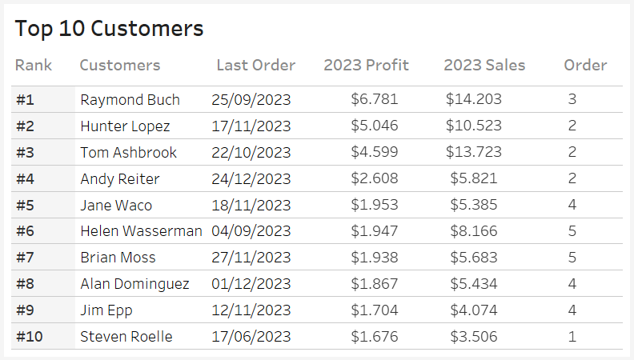
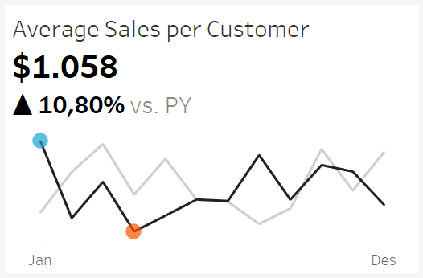
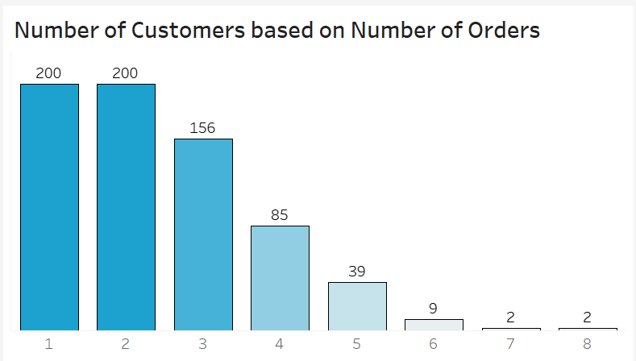
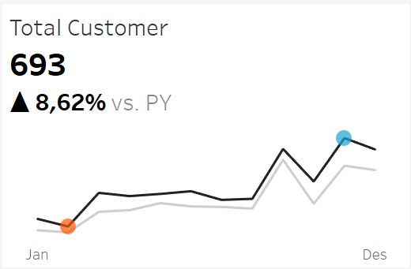
CUSTOMER DASHBOARD CONTENT
Total Customer Section
This section shows the total number of customers, the increase/decrease in the number of customers compared to the previous year (YoY), and the monthly trend of the number of customers between the year selected by the user and the previous year.

Slide 13
CUSTOMER DASHBOARD CONTENT
Number of Order
Section
This section shows the number of customers who placed orders with a certain quantity.

Slide 14
CUSTOMER DASHBOARD CONTENT
Average Sales Section
This section shows the average sales per customer, the increase/decrease in average sales per customer compared to the previous year (YoY), and the monthly trend of average sales per customer between the year selected by the user and the previous year.

Slide 15
CUSTOMER DASHBOARD CONTENT
Top Customer Section
This section shows the top 10 customers based on the profit generated through their orders, along with details about those customers.

Slide 16
CUSTOMER DASHBOARD CONTENT
Total Order Section
This section shows the total orders, the increase/decrease in total orders compared to the previous year (YoY), and the monthly trend of total orders between the year selected by the user and the previous year.

Slide 17
Thank you

